Slide 1
Henry Frodsham BSc FYP 2025-26
a concurrency based game environment

Slide 2
An overview of my project
Genre: Real-time strategy with split-screen multiplayer
Country based: the classic strategy formula of multiple countries competing
Performance focus: optimized for longer games with more units on the screen
Local Multiplayer: Supports up to 5 players (1 keyboard + 4 controllers)
Split screen with birds eye view: each player has a dedicated portion of the screen with a bird's eye view of the game world

Slide 3
Why concurrency matters in game development
Responsiveness: Keeps UI and input smooth during performance-intensive operations
Performance: Parallelizes game logic across threads for faster execution
Hardware Utilization: Leverages modern multi-core CPUs that would otherwise sit idle
Scalability: Enables games to handle more entities, complex AI, and detailed physics simulations simultaneously

Slide 4
Why I chose this project
Split screen rarity in RTS genre: all major studios producing real time strategy games don’t implement split screen e.g. paradox
Slow performance of major RTS games: slow performance is a common theme among popular real time strategy games such as stellaris. Most RTS games aren’t optimized for long saves.
lack of efficient concurrency: while most real time strategy games are closed source, open source RTS games such as openfront don’t implement multi threading and suffer from lack of input responsiveness as a result.

Slide 5
The technical aspects of my project
Programming language: C++
Graphics engine: Ogre3d
Concurrency focus: each player has their own game instance running simultaneously using threads
Event architecture: game instances communicate using events in conjunction with event queues to avoid race conditions
Entity storage: ECS (entity component system) used for both storage and managing modular behavior of entities
Input handling: SDL2 (software direct media layer) to read and distinguish multiple input devices

Slide 6
What’s already implemented?
Input handling: all devices currently plugged in are recognized and read
Split screen: Each input device is assigned a portion of the screen
Disconnect handling: controllers that are unplugged are automatically reconnected to the correct game instance once plugged back in
Separate camera control: each device controls the perspective on the assigned portion of the screen
Entity storage: the cube visible on the screen is stored using ECS

Slide 7
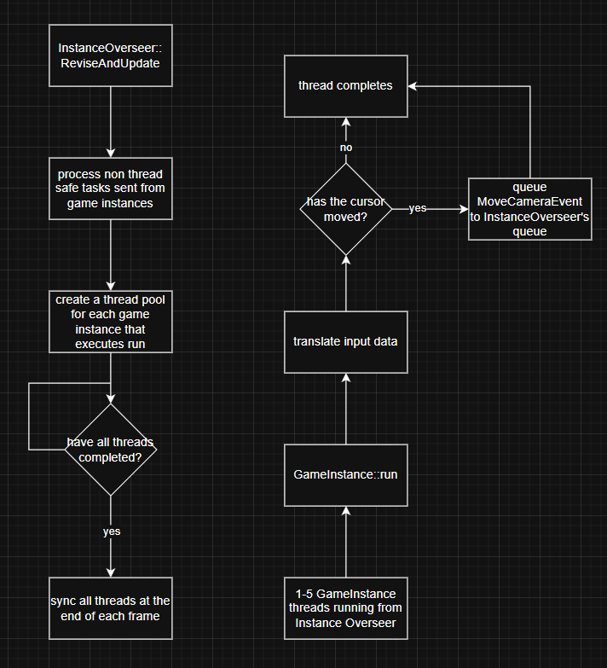
How I’ve implemented concurrency in my project
Example: camera control in a game instance thread
Key points:
Message Queue pattern: non thread safe tasks are sent to InstanceOverseer to run in the main application thread
Mutex locks: mutex locks are used on the commonly used event bus and event queue functions e.g. enqueue to prevent race conditions from occurring when accessing the queues

Slide 8
Major technologies I’ve used - ECS
What is ECS? - ECS (entity component system) is a method of storing data, separated into entities
- Each entity is separated into components which can be added or removed at any time
why ECS?
- fast operations: time complexity of O(1) for component and entity operations - entity grouping: allows similar entities to be stored contiguously for cache efficiency - modular behavior: each entities behavior can be changed by adding or removing a component

Slide 9
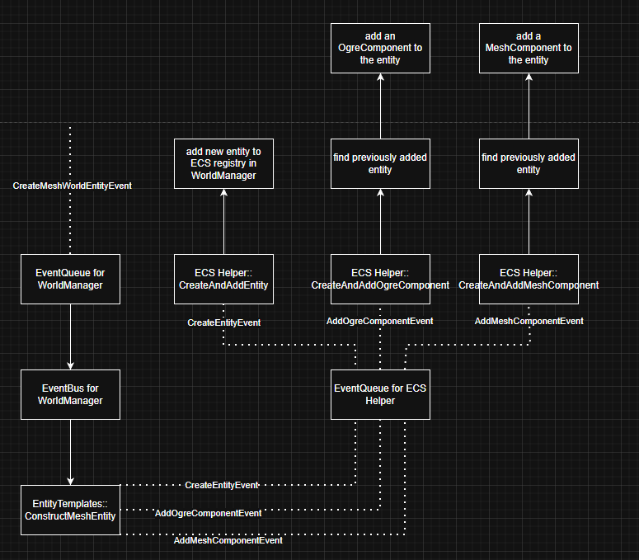
example of how I use ECS in my project
Creation of the example cube
Key points
Pointers to important data or objects are stored in each component. Allowing for easy access when iterating over entities
the ECS entity is created first then subsequent events add components to the same entity

Slide 10
Major technologies I’ve used – SDL2
What is SDL2
SDL (simple direct media layer) is a C++ library that provides a layer of abstraction to hardware. This allows it to read input from a variety of devices and isn’t platform specific
Why SDL2?
Multiple devices: SDL can read multiple devices at the same time and are easy to distinguish via SDL id’s
Cross platform: SDL supports numerous platforms without the hassle of using platform specific apis

Slide 11
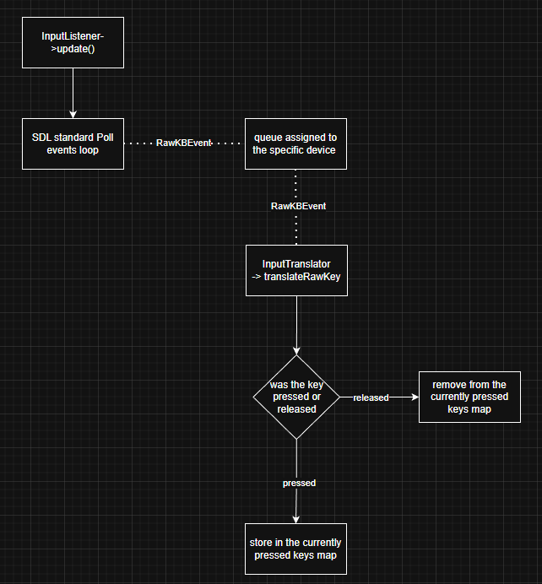
How I use SDL2 to read input for my project
How a keypress event is processed
Key points - input events are discovered and sent in the main program thread
- Each device has a unique input translator class which is stored per game instance
- The input translator class stores the current state of the device, including which keys are pressed and where the cursor is

Slide 12
Major design patterns I’ve used – Event architecture
What is event architecture? - event architecture eliminates direct class communication and replaces it with events (like messages) - event queues delay events being processed until explicitly asked too, at which point the events are processed one at a time
Why event architecture? Class decoupling: classes communicate via events without needing direct access
Race condition avoidance: processing events one at a time through an event queue prevent 2 tasks accessing the same resource simultaneously

Slide 13
My vision for the final version of my project
Full RTS game: implementation of a full country-based real time strategy game
REA implementation: use REA (resource entity action) for fast performance when evaluating actions between entities
User interaction: feature rich interaction between players such as rivalries and treaties
Clean UI: a simplistic UI that allows players on a controller to play at the same level as that of a keyboard

Slide 14
Thank You!

